Slide 1

SUSTAINABILITY REPORT

Slide 2

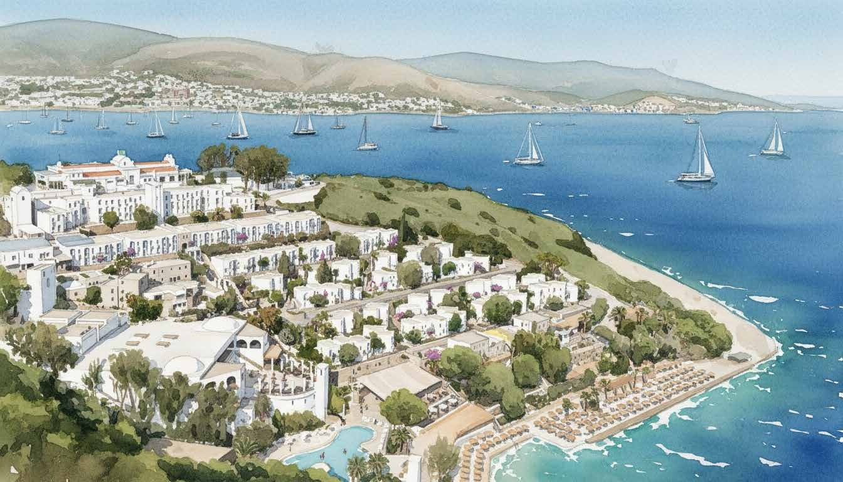
About the Report
OUR SUSTAINABILITY STRATEGY
At Başka Resort Bodrum, sustainability is a fundamental aspect of all our operations.
Our core philosophy centers on the conservation of natural resources, waste reduction, the support of local values, the assurance of equal opportunities, the promotion of respectful labor practices, and the enhancement of societal contributions.
All processes are conducted in alignment with the principles of efficiency, accountability, and sustainability.
Small decisions we make every day create a significant impact.

Slide 3
Message from Management
At Başka Resort Bodrum, sustainability is integral to our business practices.
We strive to develop a business model that honors nature, utilizes its resources judiciously and effectively, and enhances its geographical context. Our sustainability strategy is founded on a responsible tourism philosophy that safeguards and enriches not only the present but also the future.
At Başka Resort Bodrum, sustainability transcends mere aspiration; it serves as the cornerstone of our management philosophy.
Alper Argun
General Manager Başka Resort Bodrum

Slide 4
Message from Management
By incorporating sustainability principles into all our operations, we enhance interdepartmental cohesion, efficiency, and operational oversight.
We are transforming sustainability into a measurable, traceable, we emphasize enhancing value in our region by fostering local employment and safeguarding Bodrum's distinctive natural heritage.
Mahmut Çakmakçı
Asst. General Manager
Başka Resort Bodrum

Slide 5
Sustainability Assessment Report
QUALITY AND SUSTAINABILITY
Sustainability represents a collection of values that we have cultivated and maintain collectively.
We are embedding sustainability into the core of our corporate culture across all processes, underpinned by data, training, and robust operational discipline.
OUR VISION
To become a model resort by incorporating sustainability into all operations, thereby establishing it as a fundamental aspect of business practice.
OUR MISSION
To deliver a business model that safeguards natural resources, upholds local values, and engages both employees and guests in this endeavor.
Respect for nature, appreciation of culture, and accountability for the future.

Slide 6

Our policies
PROTECTION OF THE ENVIRONMENT AND NATURAL RESOURCES
Energy and water consumption are monitored, analyzed, and managed according to principles of efficiency.
In landscaping, plant species that are well-suited to the region and necessitate minimal water consumption are favored.
Harmony with nature is essential to sustainability.
WASTE MANAGEMENT AND WASTE REDUCTION
Waste generation is minimized, and waste is segregated at the source.
Food waste is effectively managed and reduced.
Preventing waste represents the initial step toward conservation.

Slide 7

Our policies
SUSTAINABLE PROCUREMENT
Local producers and sustainable products are favored.
Procurement processes are conducted with consideration for environmental and operational impacts.
SOCIAL RESPONSIBILITY AND COMMUNITY VALUES
Local producers receive support, local employment is prioritized, and regional culture is safeguarded.
The guest experience is intertwined with local values.
We are not visitors in this land, but stewards.
CHILD SAFEGUARDING AND SECURE TOURISM
A secure and regulated environment is ensured for children and all guests. Safety is a core component of our sustainability strategy.

Slide 8

Our policies
EMPLOYEE WELL-BEING AND EDUCATION
Education, equity, and professional development are supported.
Sustainability training is conducted across all departments.
Sustainability begins with individuals.
GUEST ENGAGEMENT AND AWARENESS
Guests play an integral role in our sustainability initiatives.
During the visit, information is offered regarding resource utilization, local culture, and environmental principles.
Guests are guided, informed, and engaged in the process.
Your decisions impact the environment.

Slide 9

Our Practices
TECHNICAL SERVICE
LED conversion initiatives are underway.
Aerator installations are underway.
Regular maintenance mitigates energy and water losses.
Faults and leaks are resolved promptly.
HOUSEKEEPING
Cleaning processes are conducted using adequate amounts of water and detergent.
Controlled cleaning protocols are being instituted.
Food and Beverage
The use of single-use plastics is being curtailed, and the consumption of plastic straws is being diminished.
The consumption of products and consumables is monitored.

Slide 10
Our Practices
KITCHEN
Local and seasonal products are utilized.
Practices for reducing food waste are being implemented.
Products are utilized to their fullest value.
In this context:
Fruits and their by-products are utilized in a variety of recipes.
Food waste is regarded as a valuable reusable resource.
Lionfish is set to be incorporated into the menu as part of initiatives to address invasive species.
STEWARDING
Waste sorting has been implemented.
By selecting appropriate chemicals and employing effective dosing systems,environmental impacts are minimized… and efficiency in water and chemical usage is attained.

Slide 11
Our Practices
PURCHASING
Local suppliers are favored.
Sustainable product selection is prioritized; bulk-packaged products are favored to minimize waste; local sourcing and the procurement of goods from women entrepreneurs seek to bolster local communities.
DEPOT
The FIFO system, or "First In, First Out," is implemented to ensure effective expiration date management and to mitigate product loss and waste.
All products are stored under conditions that adhere to established temperature standards, thereby minimizing product losses attributable to heat.
The appropriate stock, minimal waste.

Slide 12
Our Practices
HUMAN CAPITAL
Local employment is encouraged.
Training sessions are currently underway.
The employment of women is being promoted.
Training and employment opportunities are offered to vulnerable groups, including the elderly, individuals with disabilities, women, and pregnant employees.
GUEST RELATIONS AND CRM
By enhancing guest engagement, active support is fostered for sustainability initiatives.
Feedback is assessed through a quantifiable system.
FRONT OFFICE
Digital transactions are increasingly prevalent, with QR codes replacing traditional paper printouts.
All guest information is accessible through a QR code.

Slide 13
Our Practices
SALES AND MARKETING
We emphasize the importance of digital communication.
Sustainability communication is being enhanced.
Local landscapes and historical landmarks are being unveiled.
LANDSCAPE
Drought-tolerant plants are favored.
Endemic and rare species are safeguarded and presented to visitors.

Slide 14
Our Practices
SECURITY
Security within the facility is maintained in compliance with relevant legal regulations and data protection principles, bolstered by technological infrastructure.
Special security measures are implemented for children and guests needing assistance, with the safeguarding of these groups regarded as a priority. Guests needing assistance include:
Children, particularly those who are unaccompanied or lacking parental supervision
Senior guests
Individuals with disabilities (physical, mental, or sensory)
Expectant guests
Individuals facing transient health issues (injury, illness, etc.)
This also includes foreign guests who may face communication barriers. who encounter challenges in communication due to language barriers, and protective, guiding, and supportive measures are implemented for these groups.
Security camera systems are employed to safeguard the well-being of guests and employees, while security protocols are consistently enhanced through ongoing training and operational assessments.

Slide 15

Our Practices
SPA AND WELLNESS
Natural and eco-friendly products are favored.
Our Turkish bath provides an opportunity to immerse our guests in the richness of our local culture.
ANIMATION
Events centered around sustainability are being organized.
QUALITY AND SUSTAINABILITY
All processes are observed within a quantifiable framework.
Performance is under evaluation and enhancement.

Slide 16
Our Practices
OUR 2026 SUSTAINABILITY GOALS
Sustainability is an integral part of our daily operations at Başka Resort Bodrum.
Our goal for 2026 is to strengthen our current practices and ensure their effective implementation across all departments.
To monitor water, energy, and waste in a regular and comparable manner
To track and evaluate sustainability performance across all departments
To expand practices aimed at reducing food waste and unnecessary consumption
To increase the use of local and sustainable products
To reduce single-use items
To ensure proper waste separation
To provide sustainability training to employees and increase their engagement
To inform guests about sustainability and involve them in the process
To regularly review and improve all practices

Slide 17
Our Practices
OUR 2030 SUSTAINABILITY GOALS
Başka Resort Bodrum aims to improve its sustainability performance based on the year 2026.
In this context:
To reduce water consumption by 10%
To increase energy efficiency by 10%
To reduce food waste by 10%
To increase the waste recycling rate by 10%
To increase the use of local and sustainable products by 10%
To reduce single-use items by 10%
To increase annual sustainability training hours per employee (e.g., from 8 hours to 12 hours)
To enhance female employment and promote equal opportunities
To increase employee participation in sustainability processes
To improve guest awareness

Slide 18
Our Practices
CONCLUSION
At Başka Resort Bodrum, sustainability is of utmost importance;
It is a management philosophy that we adopt in collaboration with our employees, guests, and business partners.
A different model of tourism is possible. It can be realized collectively.

Slide 19
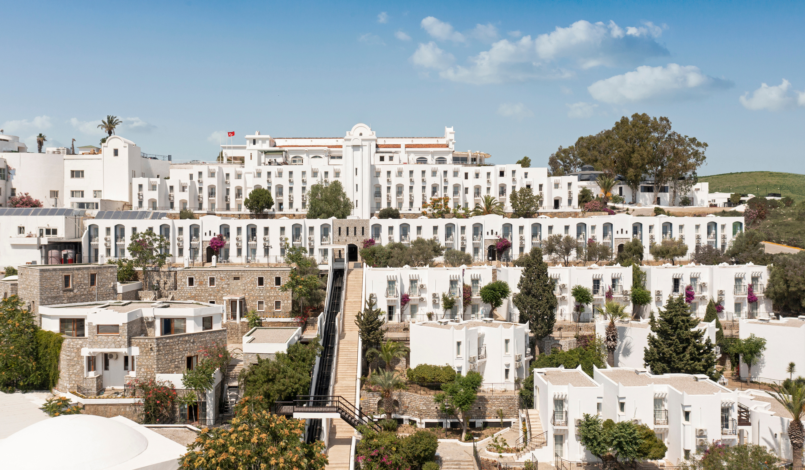
Our offerings
Prepared by: Özen Kaya, Quality and Sustainability Manager
Contributor: Başka Resort Bodrum Management

